Slide 1

Neurological Conditions Treated at Holy Cross Hospital

Slide 2
Course content and Aims
To provide an understanding of the main conditions we treat at Holy Cross .
The basic anatomy and physiology of these conditions.
The common complications of these conditions.
The Principles of person centred Care and our philosophy.
Questions and Answer session.
Further reading and training opportunities.

Slide 3
Neurological conditions managed at
Holy Cross
Stroke-Cerebral Vascular Accident
Acquired Brain Injury -Traumatic and Hypoxic
Muscular Dystrophy
Multiple Sclerosis
Motor Neurone Disease
Spinal Cord Injury
Guillain Barre Syndrome
Hydrocephalus
Epilepsy

Slide 4
Key principles of Care
At Holy Cross we provide Person Centred Care – Understanding the Person needs and preferences to deliver the best care possible, with respect and compassion.
How do we achieve this
The person is central to all our interventions.
We take into account the persons preferences, past and present – The patient profiles “Getting to know me ” helps us achieve this as well as working and listening to our patients and their family and friends.
We work as a Team to provide a consistent approach to patient care.
Physical Health – Understand the Physical Health needs of the person, both the Primary and Secondary conditions. The risk and management of the person with the condition e.g. monitoring diabetes, temperature control, infection, epilepsy , shunt blockage, spasm, pain, fatigue etc.
Continence care – Bowel and urine output management – interventions / risk
Skin – Vulnerability, pressure issues, equipment – interventions / risk
Mobility – Moving and handling, equipment, posture and positioning - risk
Behaviour – Fatigue, triggers ABC charts, Verbal and Physical abuse / injury / risk behaviours to others or self

Slide 5

6. Cognition – A persons understanding of their world - short and long term memory deficits and cognitive changes and implications including - Safeguarding ,DOLS.
7. Communication – Strategies - closed questions, equipment.
8. Posture and positioning – Repositioning guidelines, Spasm and Tone, Splinting.
9. Medication – Route of medication – effects of medication.
10. Nutrition – Diet and fluid – route – weight BMI – impairment of oral intake and swallow.
11. Breathing – Respiratory rate –SATS – mechanical assistance, Trachea care – suction and inner tube change
12. Psychological and Emotional – Anxiety, depression, low mood, poor concentration.
13. Altered states of Consciousness – Epilepsy, unresponsive.
14. Resuscitation (DNAR) - End of life care plan.

Slide 6
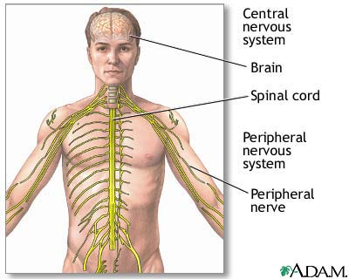
NERVOUS SYSTEM
Coordinates all parts of the body
Central nervous system – brain and spinal cord
Peripheral nervous system – spinal and peripheral nerves

Slide 7
THE BRAIN
FRONTAL LOBE
Emotional and behavioural control
Intellect, reasoning, problem solving, planning, concentrating
Personality
PARIETAL LOBE
Making sense of the world
Facial recognition
Maths
OCCIPITAL LOBE
Vision
Colour identification
TEMPORAL LOBE
Memory
Understanding language

Slide 8
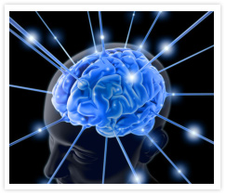
THE BRAIN
Control and Command centre
Receives information from the environment e.g. taste, pressure, touch, vision, hearing and balance.
Organises appropriate response.
Responses can range from appropriate speech and behaviour to muscle activity and movement.
Memory and learning – past, present, short and long term.

Slide 9
CELLS – 2 types
GLIAL CELLS
Supporting cells
Provides a framework supplying oxygen and nutrients and removing waste products
NEURONES
Send impulses to and from various parts of the body
Motor neurones - make muscles contract
Sensory neurones - convey sensation, and control higher functions e.g. concentration
Protected by myelin sheath which speeds up conduction of impulses

Slide 10
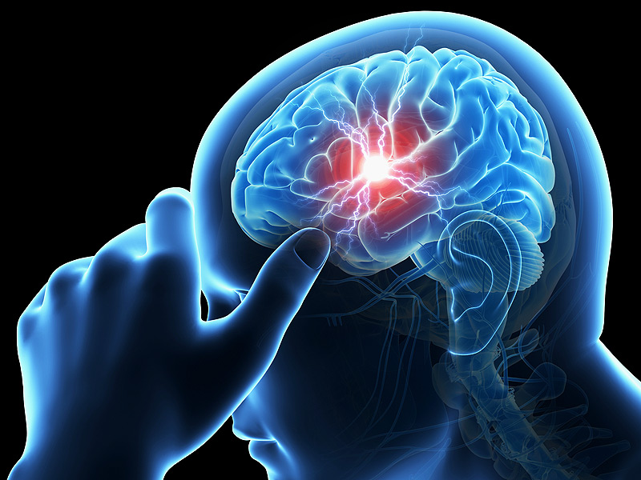
Stroke-Cerebral Vascular Accident
A stroke (CVA) is a serious, life-threatening medical condition that occurs when the blood supply to part of the brain is cut off.
Strokes are a medical emergency and urgent treatment is essential because the sooner a person receives treatment for a stroke, the less damage is likely to happen

Slide 11
Signs and Symptoms
The main symptoms of stroke can be remembered with the word FAST: Face-Arms-Speech-Time.
Face – the face may have dropped on one side, the person may not be able to smile or their mouth or eye may have dropped.
Arms – the person with suspected stroke may not be able to lift both arms and keep them there because of arm weakness or numbness in one arm.
Speech – their speech may be slurred or garbled, or the person may not be able to talk at all despite appearing to be awake.
Time – it is time to dial 999 immediately if you see any of these signs or symptoms.

Slide 12
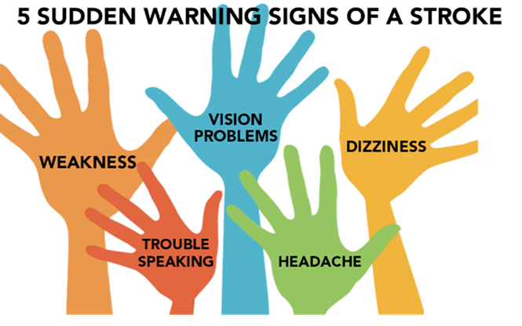

Slide 13
Causes of a STROKE
Like all organs, the brain needs the oxygen and nutrients provided by blood to function properly. If the supply of blood is restricted or stopped, brain cells begin to die. This can lead to brain injury, disability and possibly death.
There are two main causes of strokes:
Ischaemic – where the blood supply is stopped due to a blood clot (this accounts for 85% of all cases)
Haemorrhagic – where a weakened blood vessel supplying the brain bursts example of this is an Arachnoid haemorrhage
There is also a related condition known as a transient ischaemic attack (TIA), where the supply of blood to the brain is temporarily interrupted, causing a "mini-stroke" often lasting between 30 minutes and several hours. TIAs should be treated seriously as they are often a warning sign that you are at risk of having a full stroke in the near future

Slide 14
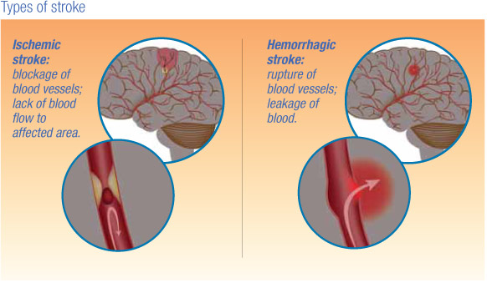
Treatment
Effective treatment of stroke can prevent long-term disability and save lives.
The specific treatments recommended depend on whether a stroke is caused by a blood clot obstructing the flow of blood to the brain (ischaemic stroke) or by bleeding in or around the brain (haemorrhagic stroke).
Treatment will usually involve taking one or more different medications, although some people may also need surgery

Slide 15
STROKE
In the UK, strokes are a major health problem. Every year, around 110,000 people have a stroke in England and it is the third largest cause of death, after heart disease and cancer. The brain injuries caused by strokes are a major cause of adult disability in the UK.
Older people are most at risk of having strokes, although they can happen at any age – including in children.
If you are south Asian, African or Caribbean, your risk of stroke is higher. This is partly because of a predisposition (a natural tendency) to developing high blood pressure , which can lead to strokes.
Smoking, being overweight, lack of exercise and a poor diet are also risk factors for stroke, as are high cholesterol , arterial fibrillation and diabetes .

Slide 16
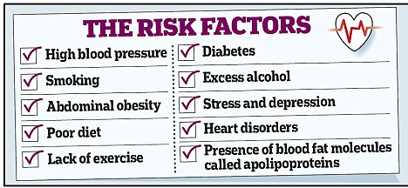
Around one in every four people who has a stroke will die, and those who do survive are often left with long-term problems resulting from the injury to their brain.
Some people need to have a long period of rehabilitation before they can recover their former independence, while many will never fully recover and will need support adjusting to living with the effects of their stroke.

Slide 17
Problems that might be present following a Stroke
Loss of Function –Movement ,Hemiplegia ,contractures –low and high tome
Communication –Receptive and expressive Dysphasia and Dysarthria
Swallowing –Dysphagia –increased risk of chocking
Visual difficulties – visual neglect and tunnel vison
Cognition difficulties –processing of information ,Memory , Apraxia, Sequencing ,Executive function .
Emotional and psychological –Lability ,depression , euphoria –withdrawal from social interaction
Behaviour –erratic ,impulsivity ,poor motivation, short tempered ,irritability
Body functions –Continence etc

Slide 18
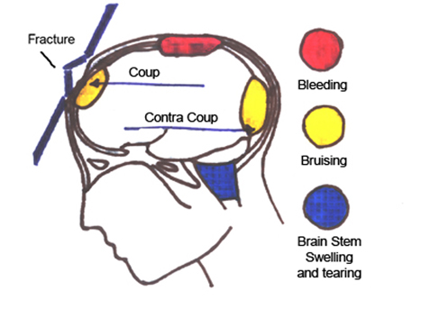
ACQUIRED BRAIN INJURY
Physical problems - loss of movement, fatigue, epilepsy, speaking and swallowing disorders, incontinence, disturbance in body temperature, headache
Cognitive problems – refers to our mental abilities e.g. memory, speed of thought, understanding, concentration, problem solving, insight, using language
Behavioural problems – agitation, aggression, inappropriate language, impulsiveness.
Damage to brain caused by trauma, stroke, haemorrhage, tumour, infection or lack of oxygen.
Pathways carrying information to and from your brain in order for you to function are damaged.

Slide 19
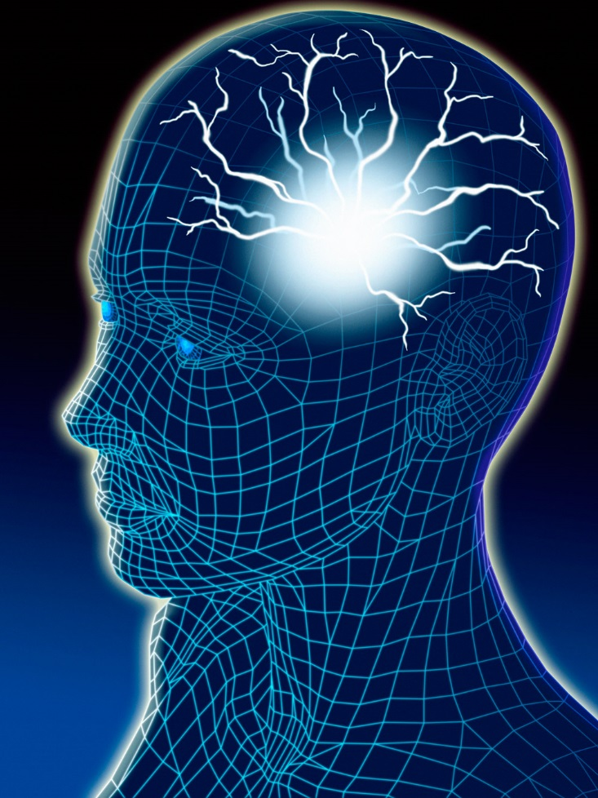
Acquired Brain Injury
An Acquired Brain Injury (ABI) is any sudden
damage to the brain received during a person’s
lifetime and not as a result of birth trauma.
“A non-progressive acquired injury to the brain with
sudden onset.”
Each injury is unique, which means that symptoms
can vary widely according to the extent and location
of the damage to brain tissue.

Slide 20
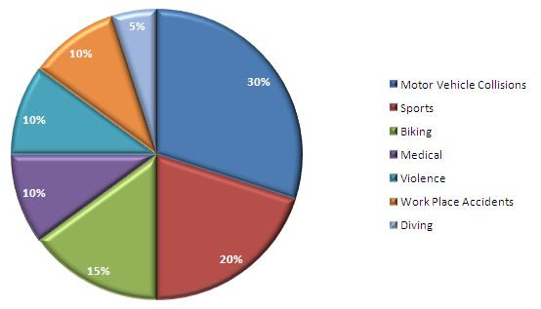
What causes an acquired brain injury?
An acquired brain injury can result from:
• A traumatic injury such as a road traffic accident,
a fall, an assault or a sporting injury
• Stroke
• Brain tumour
• Haemorrhage
• Viral infection e.g. meningitis, encephalitis or
septicaemia
• Lack of oxygen to the brain e.g. as a result of a
heart attack (anoxia/hypoxia)

Slide 21
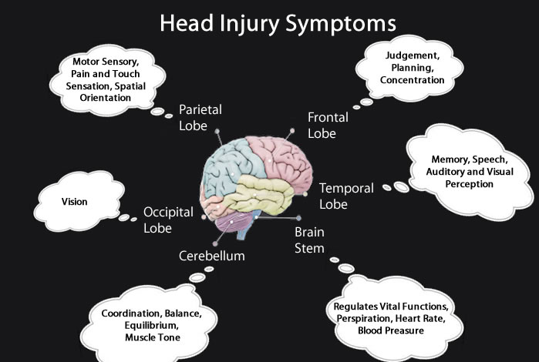
Following a brain injury, many changes occur that
may be either temporary or permanent. Each person
is unique, and the changes depend upon the type,
severity and location of injury as well as the person’s
pre-injury personality and abilities. The extent of
some changes may only become apparent as time
progresses.
Symptoms
Behavioural changes:
• Impulsivity
• Irritability
• Inappropriate behaviour
• Self –centredness
• Depression
• Lack of initiative
• Sexual behaviour

Slide 22
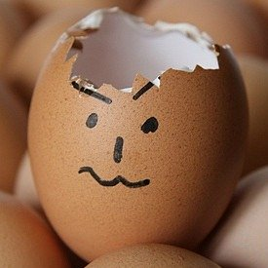
Symptoms continued -
Cognitive changes – alterations in the ability to
think and learn:
• Lack of insight
• Memory problems
• Poor concentration
• Slowed responses
• Poor planning and problem solving
• Inflexibility
• Communication difficulties
Physical changes:
• Fatigue
• Headaches
• Chronic pain
• Loss of taste and smell
• Seizures
• Visual and hearing problems
• Sexual function

Slide 23
Disorder of consciousness
The majority of our patients at Holy Cross have a disorder of consciousness. This may have been due to Trauma or Hypoxia
These patients are unable to communicate their needs and preferences in any way and are fully dependent. They require all their needs to be anticipated and met in their best interest. We do not know if they are generating their own thoughts or are stimulus bound. We provide specialised care adhering to the College of Physicians guidelines. Their care follows the same principles of person centred care.
We provide a structured day which enables times of stimulation and quiet time so the patient is not bombarded by stimuli. The skill of the nursing, care and therapy teams is paramount in managing this group of patients and requires acute clinical observation to identify any complications e.g. infections, increase in spasm or tone etc.
You will receive further training on this condition and management which will be detailed .

Slide 24
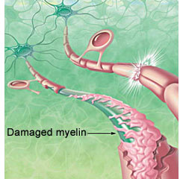
MULTIPLE SCLEROSIS
Most common disabling neurological condition affecting young adults
Approximately 85,000 people in the UK have MS
Result of damage to myelin – a protective sheath surrounding nerve fibres of the central nervous system
Damage interferes with messages between brain and other parts of the body
Some people have periods of relapse and remission
In others, the disease has a progressive pattern
It makes life unpredictable for all

Slide 25
Management of MS
The condition is managed according to the severity of the disease and the presenting symptoms.
Nurses and Therapists play a Key role in helping the person with MS manage there condition and provide intervention as and when needed not all people with MS will require the same level of intervention or experience the same symptoms .
Co ordination affecting upper and lower limbs –immobility
Fatigue – education in the pacing of activity to manage a lifestyle
Continence – Infections and Bladder/Bowel control
Mobility – dependency equipment
Posture - positioning, seating – equipment
Skin integrity –pressure areas
Communication-strategies – equipment
Spasticity management - medication

Slide 26
Management of MS
Swallowing – eating and drinking modified diet – PEG
Medication – regular reviews of medication by Neurologist to manage condition
Psychological support – episodes of Depression and euphoria – emotional lability
Long term support from a nurse clinical specialist for MS –advice on benefits, working, environment – How to live with the disease .Some peoples Disease process is very progressive and will require end stage care either in their own homes or in a care/hospital setting dependent on the presenting clinical picture.

Slide 27
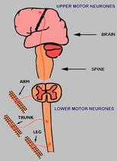
MOTOR NEURONE DISEASE
Progressive neuro-degenerative disease
Attacks upper and lower motor neurones
Leads to increasing weakness and wasting of muscles, loss of mobility and difficulties with speech, swallowing and breathing

Slide 28
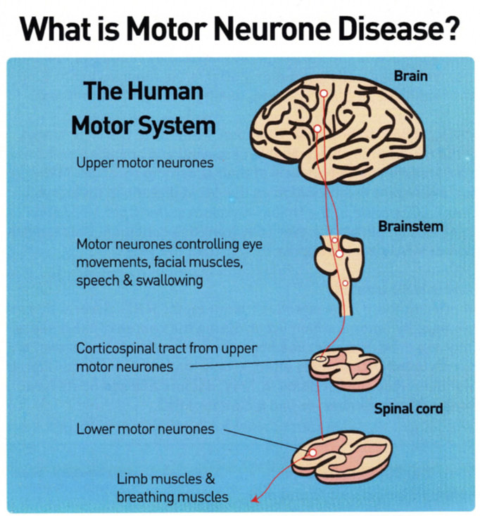

Slide 29
Motor Neurone Disease
MND is an umbrella term for Amyotrophic Lateral Sclerosis, Progressive Bulbar Palsy, Progressive muscular dystrophy and Primary lateral sclerosis.
Men are more commonly affected than Women
More than 50% of people diagnosed die within 3 years
A higher incident is recorded in those with a family history – indications of genetic in 5-10% of those diagnosed.
Symptoms can include -
Impaired swallow
Psychological lability, Anxiety
Cramps, pain
Spasticity
Speech difficulties
Insomnia
Respiratory Distress
Reduced Muscle power, immobility

Slide 30
The muscles first affected tend to be those in the hands, feet and mouth, dependent on which type of the disease the patient has been diagnosed with.
MND does not usually affect the senses (sight, sound, touch) or the bladder and bowel.
Some people may experience changes in thinking and behaviour, often referred to as cognitive impairment, but only a few will experience severe cognitive change.
The effects of MND can vary enormously from person to person, from the presenting symptom's, and the rate and pattern of the disease progression, to the length of survival time after diagnosis
The management of the disease is directly related to the presentation of the symptoms the person is experiencing and the stage /advancement of the disease. The MDT work together to provide the interventions to meet these needs in all care domains.

Slide 31
Muscular Dystrophie’s
The muscular dystrophies (MD) are a group of inherited genetic conditions that gradually cause the muscles to weaken, leading to an increasing level of disability.
MD is a progressive condition, which means it gets worse over time. It often begins by affecting a particular group of muscles, before affecting the muscles more widely.
Some types of MD eventually affect the heart or the muscles used for breathing, at which point the condition becomes life-threatening.
There's no cure for MD, but treatment can help to manage many of the symptoms.
What causes muscular dystrophy?
MD is caused by changes (mutations) in the genes responsible for the structure and functioning of a person's muscles.
The mutations cause changes in the muscle fibres that interfere with the muscles' ability to function. Over time, this causes increasing disability.

Slide 32
Types of Muscular Dystrophy
There are many different types of MD, each with somewhat different symptoms. Not all types cause severe disability and many don't affect life expectancy.
Some of the more common types of MD include:
Duchenne MD – one of the most common and severe forms, it usually affects boys in early childhood; men with the condition will usually only live into their 20’s or 30’s
Myotonic Dystrophy – a type of MD that can develop at any age; life expectancy isn't always affected, but people with a severe form of myotonic dystrophy may have shortened lives

Slide 33
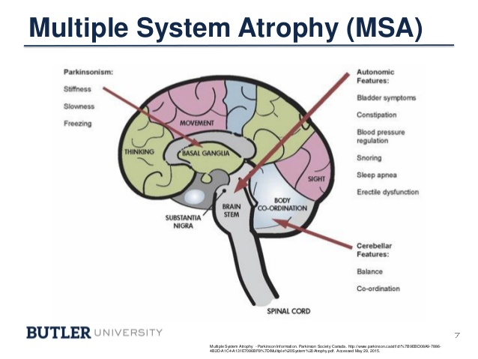
Multiple system atrophy is a disease of the nervous system that leads to premature death. It results in parts of the brain and spinal cord gradually becoming more damaged over time.
It also causes a gradual loss of brain cells from the autonomic nervous system – the nervous system in charge of automatic functions we don't have to think about, like breathing and bladder control.
This results in a wide range of symptoms, including the muscle control problems seen in
Parkinson's Disease
Symptoms usually start between 50 and 60 years of age, but can start any time after 30.
Many different functions of the body can be affected, including the urinary system, blood pressure control and muscle movement.

Slide 34
Multiple System Atrophy :
signs and symptoms
shoulder and neck pain
constipation
cold hands and feet
problems controlling sweating
muscle weakness in the body and limbs – it may be more pronounced in one arm or leg
uncontrollable laughing or crying
sleep problems – insomnia, snoring, restless legs, nightmares
noisy breathing and unintentional sighing
a weak, quiet voice
swallowing problems
blurred vision
depression
dementia (although this is uncommon)
Dystonia
Co ordination /balance
Urine /bowel problems
Swallowing Problems

Slide 35
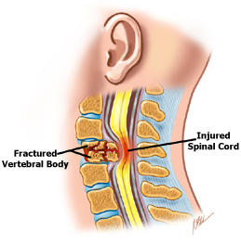
SPINAL CORD INJURY
Damage to nerve cells which make up spinal cord
Causes disruption to communication between brain and other parts of the body
Often result of trauma or something pressing on nerve cells of the cord e.g. tumour
Higher the injury the more sensation and movement someone may lose
An injury in the neck causes paralysis in all limbs – quadriplegia

Slide 36
What is the Spinal Cord ?
Brain + Spinal Cord = central nervous system
Spinal cord - main exit cable
Brain - the exchange
Spinal nerves - the branch line
Spinal cord - extension of the brain, made of a thick bundle of nerves, which branch off to connect all areas of the body to the brain.
The spinal cord works like a group of telephone wires, carrying messages in both directions from brain to individual muscles, skin, organs. ( motor function & sensory function )

Slide 37
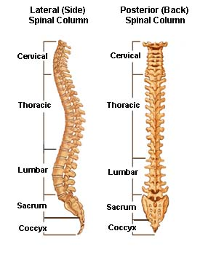
Spinal Column
The spinal cord is carried in the spinal canal, which runs through centre of the spinal column.
This is a stack of 33 bony rings called vertebrae (similar structure but change in size).
Each vertebra is separated from its’ neighbour by an intervertebral disc.
There are four major divisions of the spinal column:
  Cervical ( C ): first 7 vertebrae. ( 8 pairs of nerves )
  Thoracic ( T ): 12 vertebrae. ( 12 pairs of nerves )
  Lumber ( L ): 5 vertebrae. ( 5 pairs of nerves )
  Sacral ( S ): the last 9 vertebrae fused together into two sections, the sacrum and coccyx. ( 6 pairs of nerves )

Slide 38
What happens when your spinal cord is damaged ?
Tetraplegia ( Quadriplegic ): injury in cervical region - all four limbs and chest muscles affected
Paraplegia injury below the level of the neck (T1 and below) – legs and abdomen affected
Movement in your trunk and chest will depend on the level of lesion.

Slide 39
Complete and incomplete paralysis
Extent of paralysis and degree of effect on bodily functions depends on degree and level of injury
Complete paralysis - segment of the spinal cord is totally damaged ( no movement or sensation below the level of the lesion ).
Incomplete paralysis - only partial damage to the cord ( some messages continuing to pass between the brain and your muscles and organs )
Remember that every person’s injury is unique

Slide 40
Is There a Cure For Spinal Cord Injury ?
Regeneration & Repair of the spinal cord.
- it can never be cured by drugs.
- the nerve cells in the spinal cord are unable to spontaneously reproduce or regenerate.
- The spinal cord is unable to repair itself.
- Can’t be rejoined. No surgery. No cure for SCI.
Their bodies may behave differently, but they have learned to adapt to that.
Find many things they can do, want to do.

Slide 41
Bowel Management following Spinal Cord Injury ?
Reflex Bowel: injuries to the T12 and above. ( result in damage to upper motor neuron. No message pass, but reflex )
- management: by stimulating the rectum the bowel may push faeces from the rectum through reflex contraction, reducing the need for aperients or manual evacuation. ( a gloved lubricated finger, Glycerine supps, enema )
Flaccid Bowel: injuries to the L1 and below. ( the reflex activity of the bowel is lost ).
- management: manual evacuation of the stool.

Slide 42
Aim of Bowel Management
Avoid constipation, faecal incontinence and Autonomic Dysreflexia.
Exercise and activity
Diet ( adequate fibre ) and fluid intake ( at least 2L/day )
Abdominal massage
Oral laxatives

Slide 43
Long Term Issues
Prolonged evacuation
Constipation
Overloaded bowel
Diarrhoea
Rectal bleeding
Haemorrhoids
Autonomic Dysreflexia ( T6 or above )

Slide 44
Autonomic dysfunction
It is outside the spinal cord and is connected to it.
It controls the autonomic function of internal organs and glands (heart rate, blood pressure and sweating ).
It also works with the other part of the nervous system to control the bowel, bladder and sexual function.
Damage to the spinal cord will usually affect the ability of autonomic nervous system to function normally.

Slide 45
Autonomic Dysreflexia
the autonomic nervous system is the part of the nervous system that supplies the internal organs and digestive glands.
it has two main divisions:
- sympathetic: receive information, respond by stimulating body processes ( prepare the body for stressful or emergency situations )
- parasympathetic: inhibiting them (controls body process during ordinary situations).
overall, the two division work together to ensure that the body responds appropriately to different situations.
Notes:
Refer to clinical manual

Slide 46
What is Autonomic Dysreflexia ?
it is exaggerated response to pain stimuli, below the level of spinal cord damage.
spinal cord injury at or above T6 may potential experience. Develops suddenly and potentially become life threatening.
an irritating stimulus below the level of spinal cord injury-send nerve impulses to the spinal cord-travel upward until blocked by the lesion at the level of injury.
the impulses can’t reach the brain - a reflex is activated that increases activity of the sympathetic portion of autonomic nervous system - results in spasms and narrowing of the blood vessels (Hypertension )

Slide 47
Autonomic Dysreflexia
Causes
Symptoms
overfilling of bladder - causes over stretching or irritation of the bladder wall (Blocked catheter ).
a full bowel - causes over distension or irritation (constipation). Any stimulus to the rectum ( DRE ).
other causes: skin, boil, fractures.
severe headache
become distressed
flushed face
sweating above level of injury
increase spasm
HYPERTENSION

Slide 48
Treatment
Prevention is better than cure. ( monitored carefully, staff aware of the condition and recognise, alert, act quickly
Treat hypertension whilst identifying the cause. ( Nifidipine 10 mg sublingually )
Treat the cause. ( bladder ? Bowel ? Others ? )

Slide 49
Guillain-Barre Syndrome
acute post-infective disorder that causes damage to the peripheral and cranial nerves
a potential life-threatening neurological disease that can result in disability, but one from which most patients will make a full neurological recovery
the variable severity means that it is impossible to predict who will recover and who will be adversely affected in the long-term
the annual incidence of GBS is approximately 1-2 per 100,000 and varies slightly between countries and ages

Slide 50
Aetiology of GBS
Aetiology and pathophysiology of GBS is not completely understood
A number of potential factors that impact on the immune system are implicated in the development of the disease including both infections and vaccines.
Other potential causative triggers have been suggested, including some cancers, surgery and head trauma (Haber et al., 2009).

Slide 51
Signs and Symptoms
the symptoms of GBS usually develop two to four weeks after a minor infection, such as a cold, sore throat or gastroenteritis
symptoms often start in the feet and hands before spreading to arms and then legs.
initially with pain, tingling and numbness; progressive muscle weakness; co-ordination problems and unsteadiness
progressive and normally symmetrical loss of motor function leading to flaccid paralysis and absence of reflexes
skeletal muscle weakness may involve the diaphragm and intercostal muscles
neuromuscular respiratory failure – requiring mechanical ventilation
cardiac and autonomic dysfunction (cardiac arrhythmias, blood pressure changes and urinary retention, etc.)

Slide 52
Medical Management (acute phase)
Plasma exchange -- shown beneficial in the short term, significant adverse events, such as haemodynamic effects
Intravenous immunoglobulin (IVIg) – have similar efficacy to plasma exchange, but has fewer side-effects
Steroids – high dose oral steroid and intravenous steroids (cannot be used long-term)

Slide 53
Nursing Management
Respiratory management
Cardiac and other haemodynamic monitoring
DVT prophylaxis – flaccid nature of the paralysis, reduced mobility
Administration of IVIg (a sterile preparation of concentrated antibodies) – acute phase
Pain management – neuropathic pain (back, buttocks and thighs – described as cramping or muscular tenderness)
Bladder and bowel dysfunction – catheterisation, constipation
Nutrition – dysphagia
Communication and psychological support

Slide 54
Nursing Management (cont.)
Rehabilitation
Recovery of motor function - exercise programme, do not over-fatigue
ongoing support – GBS support group
MDT involvement

Slide 55
Epilepsy
a result of a transient disturbance of normal brain activity with abnormal excessive or synchronous discharging of cerebral neurons
the most common serious chronic neurological condition
a tendency to recurrent and unprovoked seizures of cerebral origin

Slide 56
Causes
many different types of epilepsy and various conditions can give rise to it
vary depending on the age at which the condition develops. Most developing in adulthood are focal epilepsies (e.g. structural lesions, head injury, cerebrovascular disease, etc.)
usually occur at unpredictable times and without warning, resulting disturbances of awareness, behaviours, emotion, motor function and or sensation

Slide 57
Seizure Classification
Focal or partial seizures arising from one region of cortex
simple partial seizures (full awareness is preserved, can occur with motor, autonomic, or psychic signs and systems, depending on the area of the cortex in which the seizure occurs)
complex partial seizures (maybe partial or total loss of consciousness, last for between two and three minutes, the patient does not remember what occurs during the seizure, full recovery usually takes around 10 minutes)
Generalised seizures characterised by discharges beginning diffusely throughout both hemispheres
absent seizures (sudden onset of staring with momentary impairment of consciousness lasting up to ten seconds)
tonic seizures (sudden onset of stiffening of muscles resulting in increased tone often with impaired awareness and falls)
atonic seizures (sudden loss of muscle tone without warning causing a person to fall to the ground)

Slide 58
Epilepsy CAUSES
A head injury
An infection like meningitis
The brain not developing properly
Stroke
Scar
Tumour
Poor temperature control

Slide 59
Medical Management
Antiepileptic drugs (AEDs)
recommends AEDs treatment after a second epileptic seizure has occurred (NICE, 2014)
standard first line drugs used were Carbamazepine for focal seizures and Sodium Valproate for generalised seizures
initiated at low doses with gradual increments at regular intervals to therapeutic levels
aim of AED therapy is to maintain optimal seizure control on one drug if possible with minimum adverse effects
Surgery
epilepsy is not controlled with AEDs
categorised into respective (remove an identified epileptogenic zone) and functional (palliative rather than curative, reducing the frequency, vagus nerve stimulation)

Slide 60
Nursing Management
a simple partial seizures (full awareness): gentle reassurance
tonic seizures (sudden onset of stiffening of muscles): keep patient safe, not advisable to move patient, give oxygen, check airway, not restrained, gentle reassurance after recovery, no medical intervention required.
tonic status seizures ( prolonged seizures, medical emergency, seizure is not resolving spontaneously, more than 2 minutes): physiological changes: increased cerebral blood flow with increases in oxygen and glucose delivery to the brain to meet increased demands and to protect neurones against damage.
oxygen, protect airway, safe environment, administration of medicine, monitor vital signs)

Slide 61
Hydrocephalus

Slide 62
Cerebrospinal fluid (CSF)
The brain and spine are surrounded by CSF, which is essential for cushioning the brain, providing nutrients and removing waste products
CSF is mainly produced in the choroid plexus and flows around the sub-arachnoid space surrounding the brain and spinal cord
It then passes through a series of chambers in the brain called ventricles and connecting channels called foramina

Slide 63
Cerebrospinal fluid (CSF)
We produce about a pint (500ml) of CSF per day but the brain can contain only about 120-150ml. For this reason excess CSF is drained into the bloodstream through a series of valves called the arachnoid villi. The CSF is recycled about three times a day
Hydrocephalus can occur if the flow of CSF is blocked, if the body produces too much CSF, or if there is a problem with the arachnoid villi which stops CSF being absorbed into the blood
This can cause the ventricles and sub-arachnoid space to swell as the fluid pressure increases, which may lead to permanent brain injury if prompt treatment is not received

Slide 64
Hydrocephalus
caused by a build up of fluid inside the skull, which can increase pressure and cause damage to the brain and its essential functions
a shunt is fitted to enable the fluid to drain but sometimes a shunt can be come blocked which will cause the build up of fluid inside the skull.

Slide 65
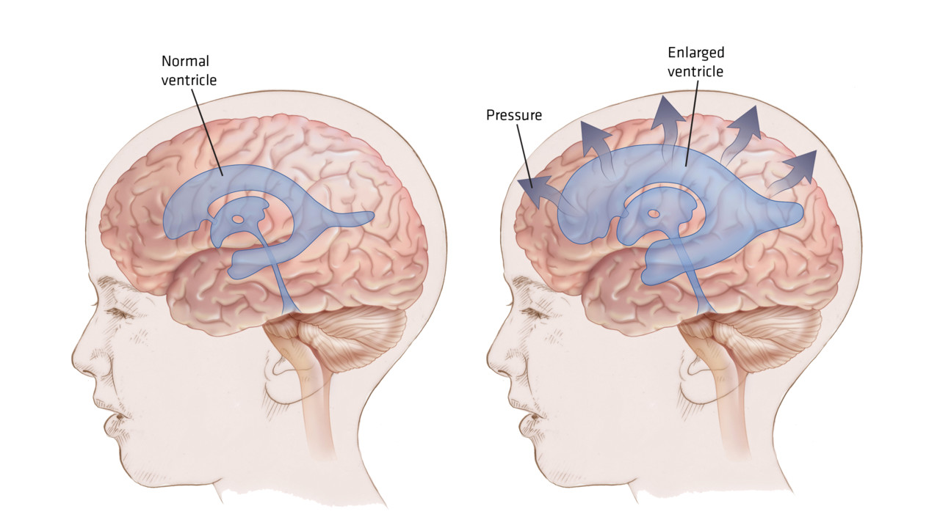

Slide 66
Hydrocephalus
Aetiology
Investigations
Meningitis
Trauma
Complication post-epilepsy surgery
Tumour
Head injury
Cranial ultrasound
CT and MRI

Slide 67
Medical Management
treatment of hydrocephalus: redirection of CSP from the normal pathway to allow for absorption of CSF at an alternative site or the diversion of CSF past an obstruction
surgical options: Insertion of a shunt – via a hydrostatic pressure gradient (ventriculo-peritoneal shunt)
VP shunt consist of
a ventricular catheter; implanted into the ventricle and connected to the reservoir
a reservoir: placed on the surface of the mastoid bone, under the scalp, contains a valve
a valve: prevents the backflow of CFS
a distal catheter: tunnelled through the subcutaneous tissue to the abdomen, and then placed into the peritoneal cavity where the CSF is reabsorbed by the peritoneum

Slide 68
Hydrocephalus
Causes
Symptoms
obstruction: common site is the ventricular end
overdrainage: can be due to inappropriate valve
infection: usually occurs within several months of insertion
headache, signs of raised ICP
low pressure headache
fever, irritability

Slide 69
Nursing Management
Nursed in a slightly raised position (increase the differential pressure gradient) to encourage the flow of CSF through the shunt system
Avoiding any pressure to the scalp overlying the valve system (prevention of skin problems around the valve site)
Monitor signs of infection and raised ICP

Slide 70
Summary
Use the care plans as a working document
Understand your patients needs and Preferences
Medical Conditions, Symptoms ,Management if you do not understand, ask a senior colleague for help – share your knowledge
If information changes about the patient care it is everyone's duty to ask a senior colleague to review and amend any information that is not accurate
Always bring any medical concerns about your patient to the attention of the nurse in charge
If you don’t know how to manage something or don’t feel confident then ask for help in enabling your skills from your manager.
You will receive further in depth training on management ,conditions whilst working for Holy Cross if you feel there is an un met need in your training then speak to your manager and highlight this in your annual appraisal and supervision.

Slide 71

Summary –Quiz-what you have learnt
MND
MD
CVA
ABI
DOC
VP
CSF
GBS
Hemiplegia
Autonomic Dysreflexia
Name 2 Cognitive difficulties following an ABI-what problems may arise in nursing a patient with these difficulties
Name 2 symptoms of Hydrocephalus and 2 actions in nurse management
Name 3 essential observations of a patient with Epilepsy
Explain a Tonic Seizure to your partner
Explain your intervention back to your partner

Slide 72

Questions ?

